Slide 1
Computer Fundamentals
Basic concepts of computer

Slide 2
What is Computer?
The computer is an electronic device that takes input from the user and processes these data under the control of a set of instructions (called program) and gives the result (output) and saves it future use.
It can process both numerical and non-numerical (arithmetic and logical) calculations.
The term computer is derived from the Latin term ‘computare’, this means to calculate or programmable machine.
Computer can not do anything without a Program. It represents the decimal numbers through a string of binary digits.

Slide 3
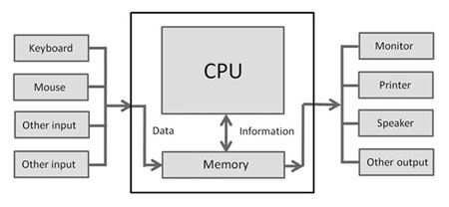
The Word ‘Computer’ usually refers to the Central Processing Unit plus Internal memory.
Charles Babbage is called the “Grand Father” of the computer.
Alan Turing is called the “Father” of computer system.
The First mechanical computer designed by Charles Babbage was called Analytical Engine. It uses read-only memory in the form of punch cards.
Structural Diagram of a Computer System

Slide 4
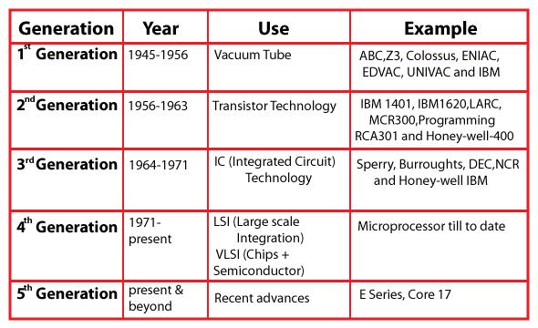
Generations of Computer

Slide 5
Functions of Computer
A computer can process data, pictures, sound and graphics. They can solve highly complicated problems quickly and accurately.
A computer performs basically five major computer operations or functions irrespective of their size and make. These are –
1) it accepts data or instructions by way of input, 2) it stores data, 3) it can process data as required by the user, 4) it gives results in the form of output
5) it controls all operations inside a computer.

Slide 6
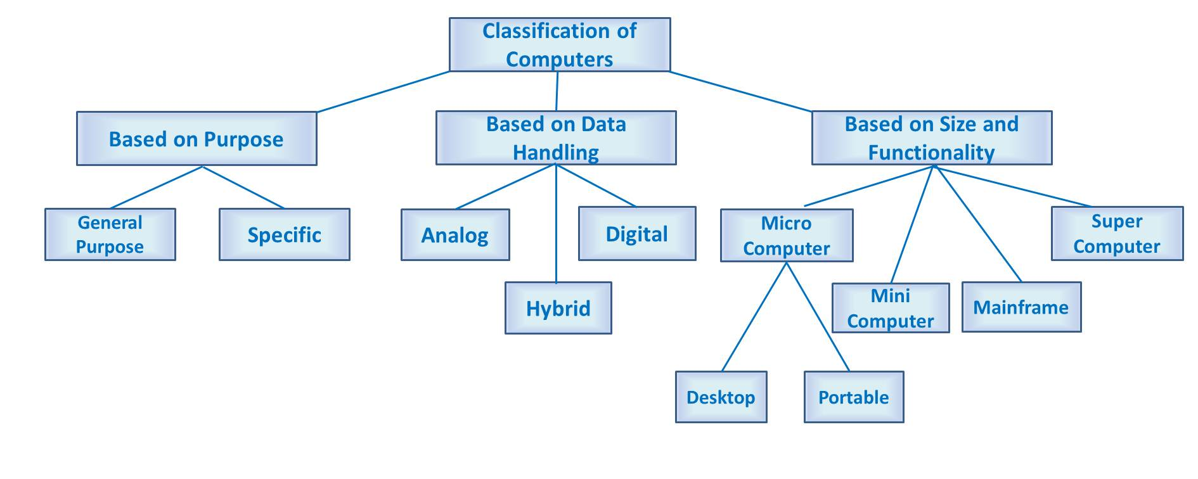
Classification of Computer

Slide 7
Basic Components of Digital Computer
The basic components of a modern digital computer are:
Input Device
Output Device
Central Processing Unit (CPU)
Storage Device (HDD)
Memory (RAM)
A Typical modern computer uses LSI Chips.
Note:
- Large - Scale Integration (LSI) is the process of integrating or embedding thousands of transistors on a single silicon semiconductor microchip.
- LSI Technology was conceived in the mid-1970s when computer processor microchips were under development.

Slide 8
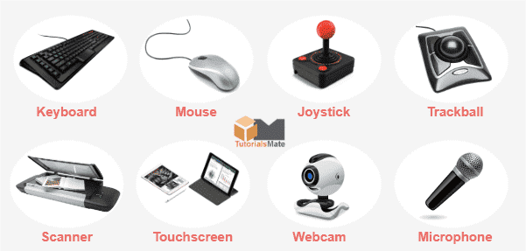
Definition of Input Device
An input device is essentially a piece of instrument or hardware that allows users to provide data, information, or control instructions to a computer used for interaction and control.
Data is entered into a computer in a raw format, which is converted into computer understandable language by input devices and processed by a central processing unit (CPU) to produce output.

Slide 9
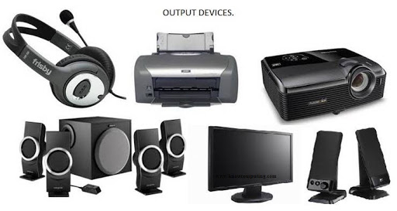
Definition of Output Device
An output device is a piece of computer hardware that receives data from a computer and then translates that data into another form. That form may be audio, visual, textual, or hard copy such as a printed document.
The key distinction between an input device and an output device is that an input device sends data to the computer, whereas an output device receives data from the computer.

Slide 10
Definition of CPU
A Central Processing Unit is also called a processor, central processor, or microprocessor. It carries out all the important functions of a computer.
It receives instructions from both the hardware and active software and produces output accordingly.
It stores all important programs like operating systems and application software.
CPU also helps Input and output devices to communicate with each other.
Owing to these features of CPU, it is often referred to as the brain of the computer.

Slide 11
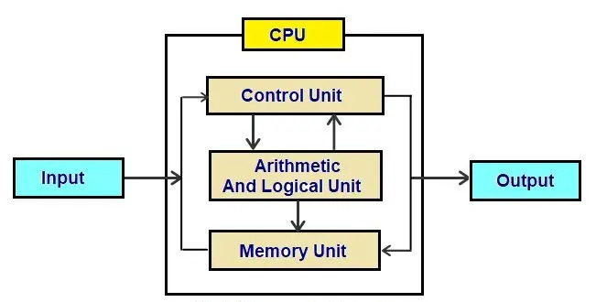
Definition of CPU
A CPU has three components –
ALU (Arithmetic Logic Unit)
Control Unit
Memory or Storage Unit

Slide 12
What do you mean by ALU
(Arithmetic Logic Unit)?
It is the arithmetic logic unit, which performs arithmetic and logical functions.
Arithmetic functions include addition, subtraction, multiplication division, and comparisons.
Logical functions mainly include selecting, comparing, and merging the data.
A CPU may contain more than one ALU. Furthermore, ALUs can be used for maintaining timers that help run the computer.
In some microprocessor architectures, the ALU is divided into the arithmetic unit (AU) and the logic unit (LU).
ALU is also known as an Integer Unit (IU).

Slide 13
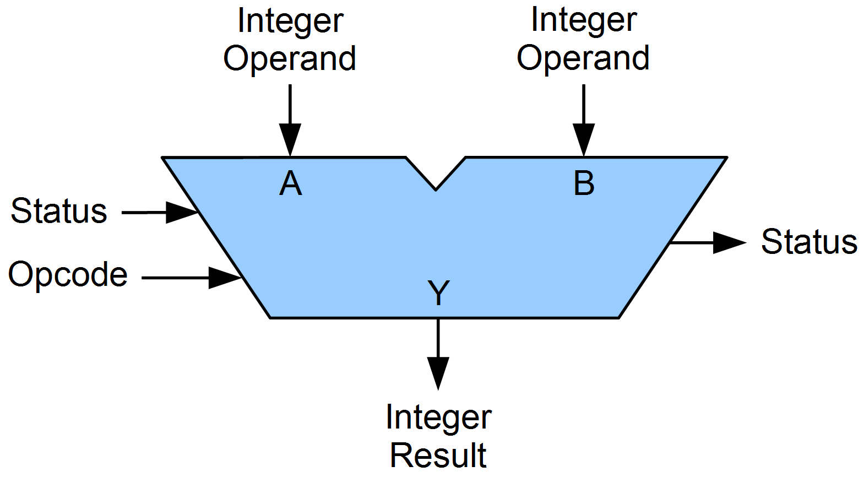
Block Diagram of ALU

Slide 14
What do you mean by Control Unit?
It is the circuitry in the control unit, which makes use of electrical signals to instruct the computer system for executing already stored instructions.
It takes instructions from memory and then decodes and executes these instructions.
So, it controls and coordinates the functioning of all parts of the computer.
The Control Unit's main task is to maintain and regulate the flow of information across the processor.
It does not take part in processing and storing data.

Slide 15
Functions of Control Unit
Functions of this unit are –
It is responsible for controlling the transfer of data and instructions among other units of a computer.
It manages and coordinates all the units of the computer.
It obtains the instructions from the memory, interprets them, and directs the operation of the computer.
It communicates with Input/output devices for transfer of data or results from storage.
It does not process or store data.

Slide 16
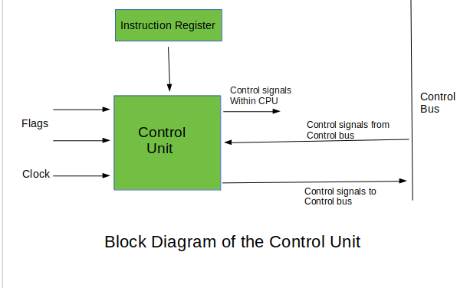
There are two types of Control Unit – Hardwired Control Unit Micro-programmable Control Unit

Slide 17
What do you mean by Memory/Storage Unit?
Memory Unit is a component of a computer system. It is used to store data, instructions and information. It is actually a work area of computer, where the CPU stores the data and instruction.
It is also known as a main/primary/internal memory.
There are two types of memory –
Read Only Memory (ROM) - ROM is a part of the memory unit. This is read only memory. It can not be used to written. ROM is used in situations where the data must be held permanently.
Random Access Memory (RAM) - RAM is also part of memory unit. It is used for temporary storage of program data. Its data is lost when power is turned off.

Slide 18
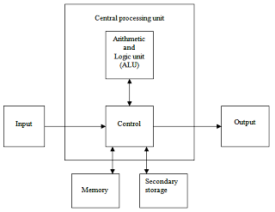
Structure of Memory/Storage Unit

Slide 19
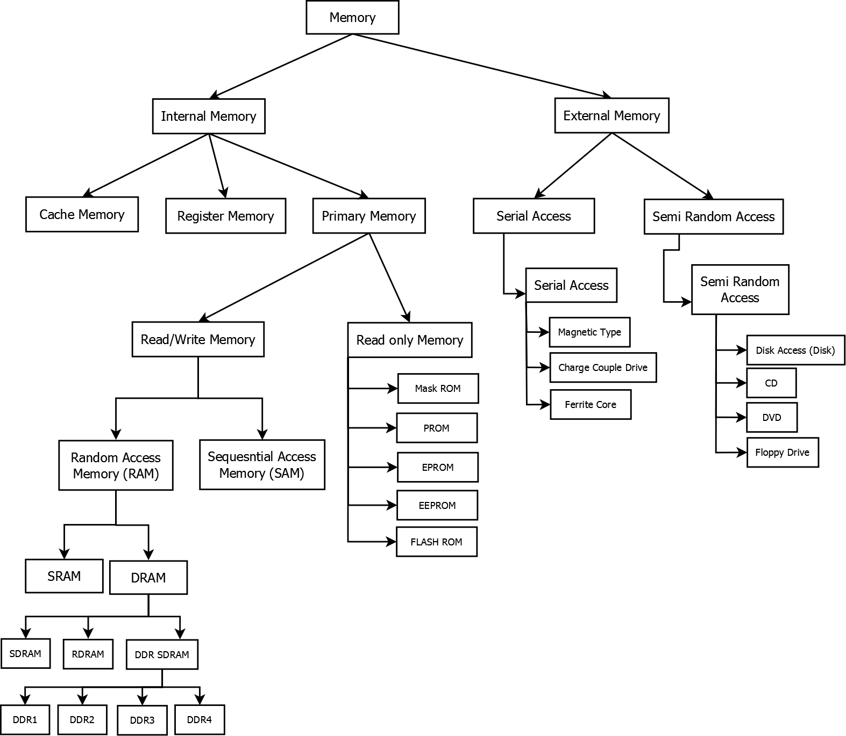
Types of Memory/Storage Unit

Slide 20
What is CPU Clock Speed?
The clock speed of a CPU or a processor refers to the number of instructions it can process in a second.
It is measured in gigahertz (GHz)
For example, a CPU with a clock speed of 4.0 GHz means it can process 4 billion instructions in a second.

Slide 21
Types of CPU
CPUs are mostly manufactured by Intel and AMD, each of which manufactures its own types of CPUs. Some of the basic types of CPUs are described below –
Single Core CPU - Single Core is the oldest type of computer CPU, which was used in the 1970s. It has only one core to process different operations. It can start only one operation at a time; the CPU switches back and forth between different sets of data streams when more than one program runs. So, it is not suitable for multitasking as the performance will be reduced if more than one application runs. The performance of these CPUs is mainly dependent on the clock speed. It is still used in various devices, such as smartphones.

Slide 22
Dual Core CPU - As the name suggests, Dual Core CPU contains two cores in a single Integrated Circuit (IC). Although each core has its own controller and cache, they are linked together to work as a single unit and thus can perform faster than the single-core processors and can handle multitasking more efficiently than Single Core processors.
Quad Core CPU - This type of CPU comes with two dual-core processors in one integrated circuit (IC) or chip. So, a quad-core processor is a chip that contains four independent units called cores. These cores read and execute instructions of CPU. The cores can run multiple instructions simultaneously, thereby increases the overall speed for programs that are compatible with parallel processing.

Slide 23
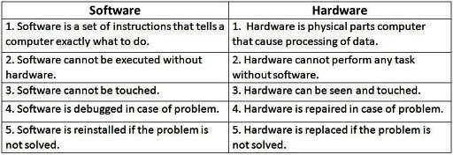
NOTE: Quad Core CPU uses a technology that allows four independent processing units (cores) to run in parallel on a single chip. Thus by integrating multiple cores in a single CPU, higher performance can be generated without boosting the clock speed. However, the performance increases only when the computer's software supports multiprocessing. The software which supports multiprocessing divides the processing load between multiple processors instead of using one processor at a time.

Slide 24
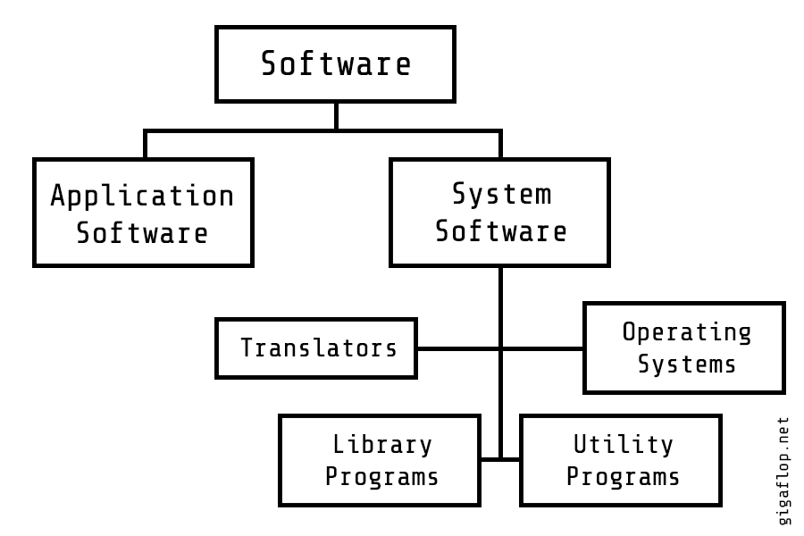
Classification of Software

